Slide 1
Cyclistic bike-share analysis case study
Presented by: Mahmoud Saad
Last updated: August 2023

Slide 2
Cyclistic, a bike-share company in Chicago, where The director of marketing believes the company’s future success depends on maximizing the number of annual memberships. Therefore, your team wants to understand how casual riders and annual members use Cyclistic bikes differently.
Scenario:

Slide 3
Making a comparison between the different using of the Cyclistic bikes between members and casual riders.
Objective:

Slide 4
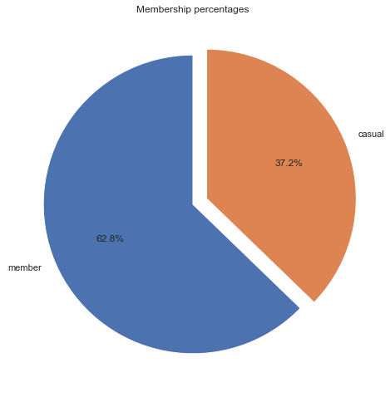
In the last 12 months, The percentage of casual riding is 37.2% of total ridings.
Casual Percentage:
These are the riders who we need to focus on to convert them to members.

Slide 5
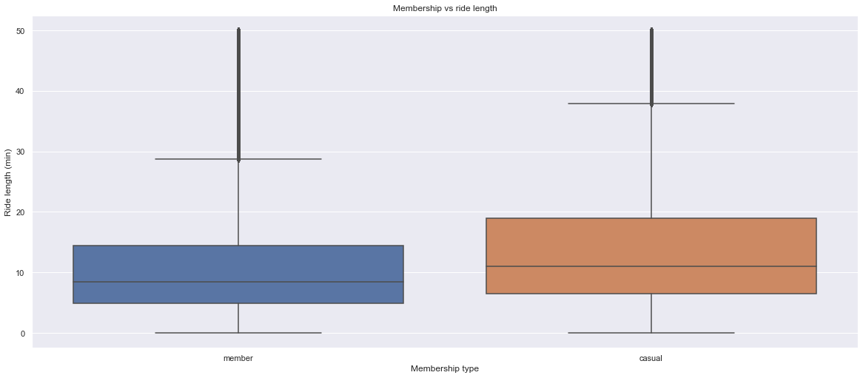
Travel length mean for casual rides is bigger than that of the member rides.
Travel Length mean:
Travel length mean for casual rides about 12 minutes per ride

Slide 6
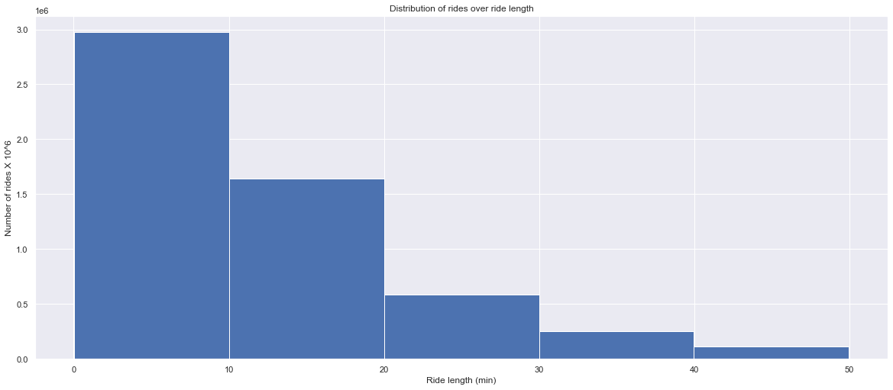
Travel length is under 10 minutes for about 3 milion ride in the last year.
Travel Length distribution:
About 82% of rides end in less than 20 minutes.

Slide 7
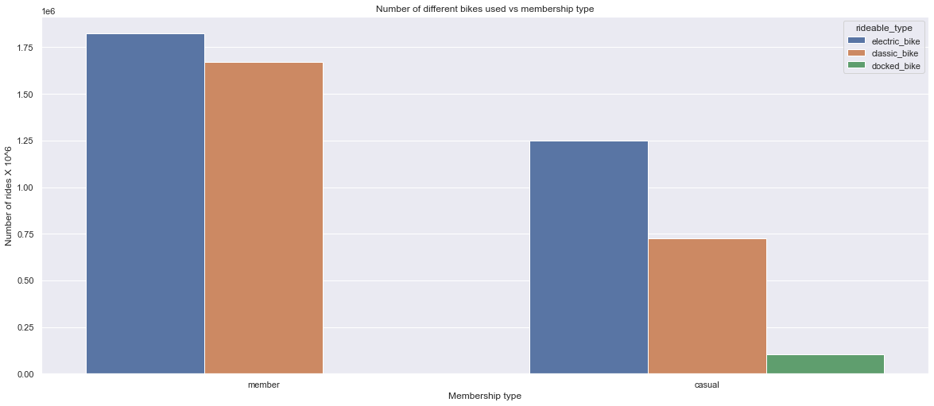
Docked bikes are used by the casual riders more than members
Bikes used:

Slide 8
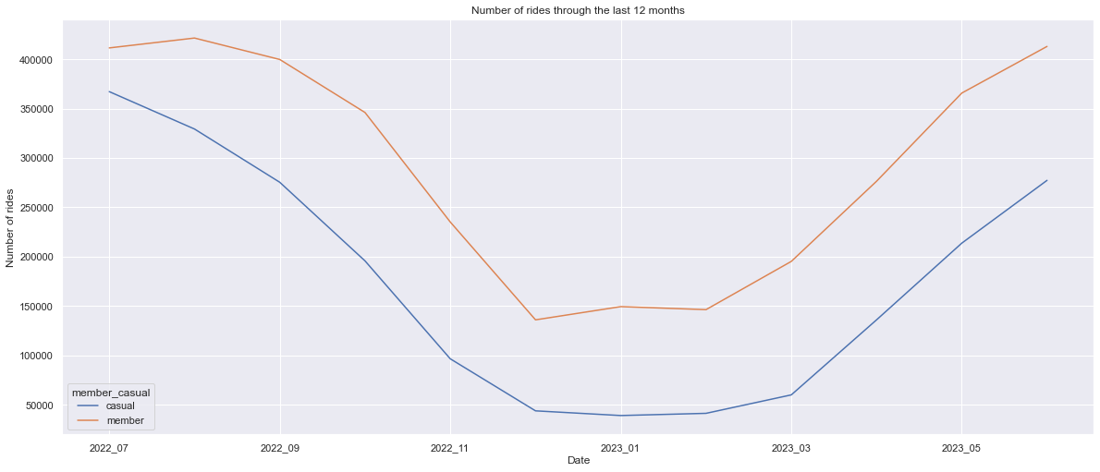
Casual and member rides take similar approach through the year.
Rides distribution throuth the year:
Rides increase during summer months and decrease during winter months

Slide 9
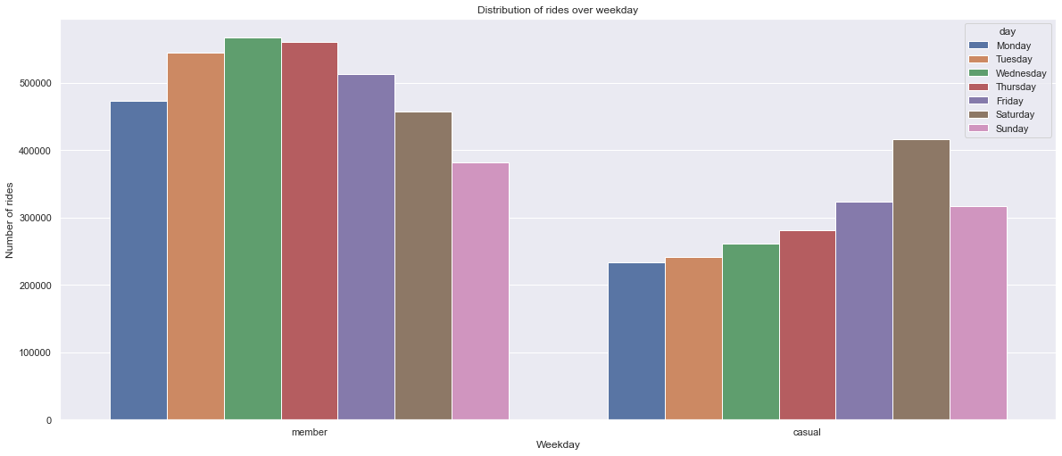
Casual rides increase at saturdays
Rides distribution through week days:
Member rides decrease during saturdays and sundays (weekend days) and increase in the other week days.

Slide 10
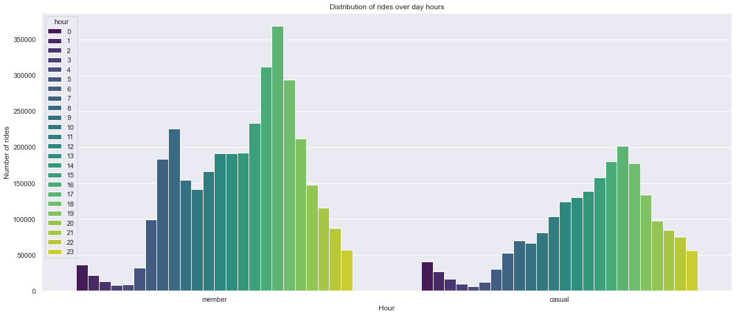
Casual rides maximum between 16:00 and 19:00 in night
Rides distribution through day hours:
Member rides has bimodes it increase betwwen 7:00 and 8:00 in morning and increase again in night between 16:00 and 19:00

Slide 11
Travel length mean for casual rides is bigger than that of the member rides.
Conclusion:
Docked bikes are used by the casual riders more than members.
Rides increase during summer months and decrease during winter months.
Casual rides increase at saturdays, while Member rides decrease during saturdays and sundays .
Casual rides maximum between 16:00 and 19:00 in night.

Slide 12
Collecting more data about casual riders to make more analysis and get wider insight of the case
Recommendations:
Recording number of repeated rides for each casual rider
Making promotions on docked bikes for members .
Making promotions on Saturday rides for members.

Slide 13
To explore the used datasets, please visit the following link: https://divvy-tripdata.s3.amazonaws.com/index.html
Appendix:
To check the analysis done, please visit the following link: https://drive.google.com/file/d/13dgqsdc0re0mtJh_NdJnh3BMLaO9BtGy/view?usp=drive_link

